Slide 1
Zero-Day Attacks
and
Countermeasures
Nafin Mahmoud – 201913152
Talha Abdullah Punjabi – 201903446
Abrar Shahriyar Hossain - 201912955

Slide 2
Introduction
Synopsis of Zero-Day Attacks
01
What is this attack?
Timeline of a Zero-Day Attack
Types of Attackers
Past Attacks
Negative and Positive Impacts
Countermeasures and Techniques Against Zero-Day Attacks
02
Prevention of Zero-day Attack
Detection of Zero-day Attack
Mitigation
Future research track
Conclusion

Slide 3
What is a Zero-Day attack?
Zero-day attacks are ones that occur because of the discovery of new vulnerabilities in a system. This attack occurs before the developers have a chance to patch the flaw.

Slide 4




Timeline of a Zero-day Attack
Creating exploit by attacker through vulnerability
Vendor distributes both the signature and patch
Developer is notified about the vulnerability
Your Text
Example Text :
Get a modern PowerPoint Presentation that is beautifully designed.
Your Text
Vendor creates the signature and patch
IT admin installs the signature and patch
Your Text
Discovery of vulnerability to the attacker
Start of attack
Example Text :
Get a modern PowerPoint Presentation that is beautifully designed.
Example Text :
Get a modern PowerPoint Presentation that is beautifully designed.

Slide 5



Types of Attackers
Cyberwarfare
Attackers
Hacktivists
Cyber
Criminals
Attackers utilize cyber-attacks against a nation to cause damage to assets
Attackers attack to gain political, social, cultural, or religious gains
Attackers who attack to mostly gain monetary gains

Slide 6

Strong Example of Zero-Day Attack
STUXNET
Cyber Weapon used against Iranian nuclear facilities
Stuxnet was built with rootkits, four zero-day exploits, and a worm
Purpose was to slow down rather than destroy facilities production
Other Zero-day attacks: Wannacry, Russian doll, Operation Clandestine Wolf, Hurricane panda, Dark Leech Attack

Slide 7
Negative Impacts of Zero-Day Attacks
Data Theft
Identity Theft
Positive Impacts
Of Zero-Day Attacks
Reputation Damage
Financial Loss
Legal Fines
Other developers become aware
Skilled individuals fight these vulnerabilities and educate others on these attacks.
Watering-Hole Attacks
!

Slide 8
Countermeasures
And Techniques

Slide 9

Prevention
Mitigation
- Before an attack
- After an attack
SECURITY
Detection
- During an attack

Slide 10
Detection Techniques
Statistical-Based Detection Technique
Signature-Based Detection Technique
Behavior-based Detection technique
Hybrid-based
Detection technique
01
02
03
04

Slide 11

Statistical-Based Detection Technique
The statistical-based method keeps track of all known historical zero-day vulnerabilities and uses that data to construct profiles that provide new criteria for detecting attacks. This approach uses its previous profile to identify which network traffic or activities to allow and which traffic or activities to prevent.

Slide 12
Signature-Based Detection Technique
Signature-based approaches are used to detect polymorphic worms and identify their new appearances on each new contamination. Anti-virus companies have libraries to store all the signatures of viruses found by searching old files and past attacks. These signatures are later used against incoming traffic to find out any viruses in the network which match the records.

Slide 13
Behavior-based Detection technique
It predicts the flow of the network and gathers information in order to find out any abnormal activities on a network. The machine learning approach will gather all the past information about network activities on the system or machine of a victim along with web servers or servers. Later it will analyze the different viruses or worms' byte patterns which will then help to filter out the network from attacks.
Internet

Slide 14
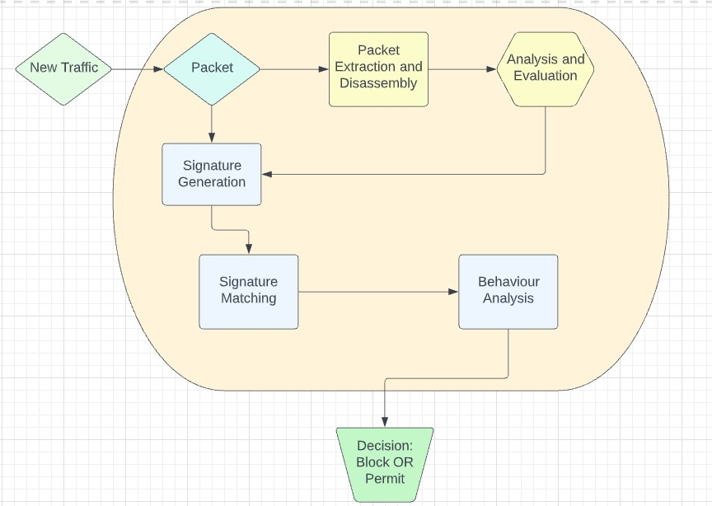
Hybrid-based Detection technique
This technique is a mixture of statistical-based, signature-based, and behavior-based techniques. The goal of this method is to combine two or all of the previous-mentioned techniques to utilize the strengths of one to compensate for the limitations of the other.

Slide 15
Prevention Techniques
Regularly updating browsers, server,
and systems with the most
up-to-date security measures
Usage of the most advanced and high-valued security software
Set up a cybersecurity team to monitor system security on a regular basis,
if possible
Examination of systems for any
unexpected or suspicious activity
Educating employees on the symptoms of vulnerabilities and typical security threats, as well as how to respond to them
Controlling of access to systems
Controlling file access to
non-whitelisted programs
Prepare a proper response and recovery plan in the event of an attack

Slide 16

Mitigation Techniques
Encouraging system users to have their systems updated after every major security patch
Reporting and diagnosing unusual activities
Securing and containing possible sources of an attack
Having Recovery

Slide 17
Future
Research Track
At present, the main problems which are open are
virtualization, web-based application, cloud computing
and others which are not included in common studies
related to zero-day attacks. Considering this, it is
paramount that further research be carried out in
detecting and mitigating these attacks.

Slide 18
Conclusion
Zero-day attacks are getting larger and bolder and is expected to rise to a larger extend in the upcoming years. Priority must be given to securing data by an organization and being aware of newly discovered attacks and their preventions.

Slide 19
THANK YOU
Any Questions ?

